Slide 1
Name | Cameron
Git Hash | c9175e76c1169eed9f00eb8c9a82329c865ecca4
Sprint number | Start date | end date | Work hard rating
 | 30/5/2022 | 10/6/2022 | 4/5

Slide 2
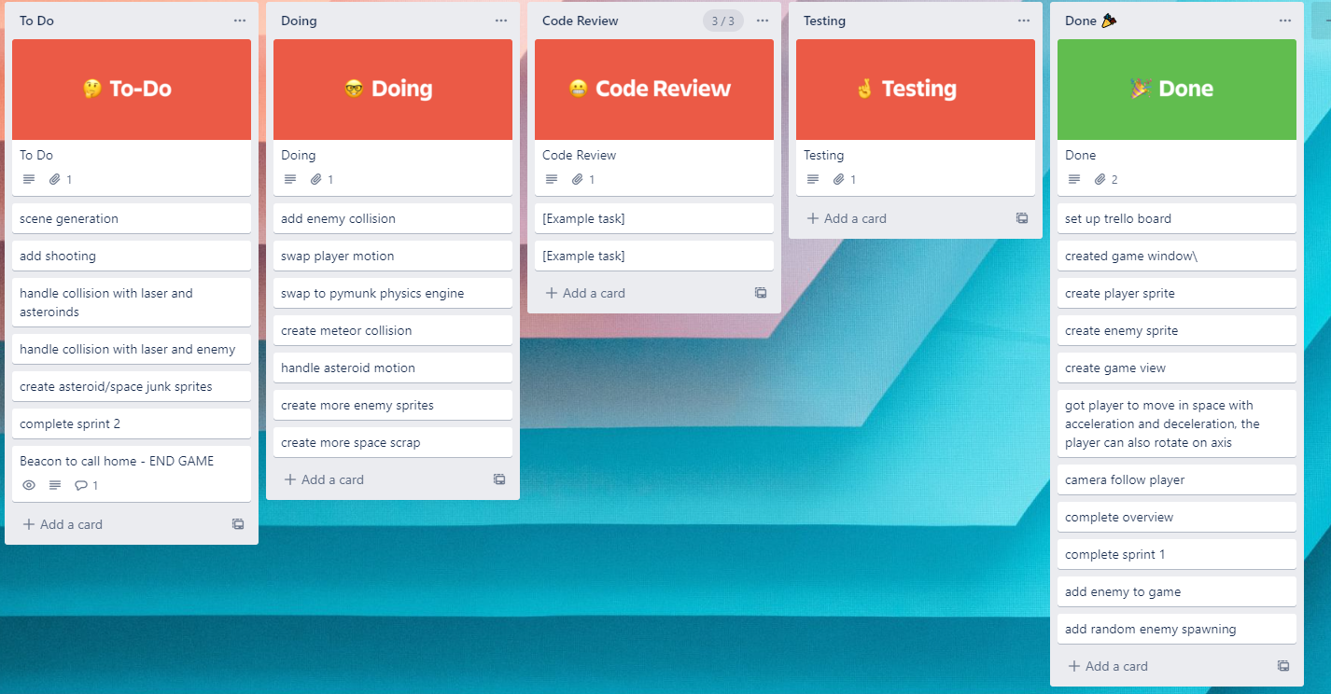
KANBAN board at the start of the sprint

Slide 3
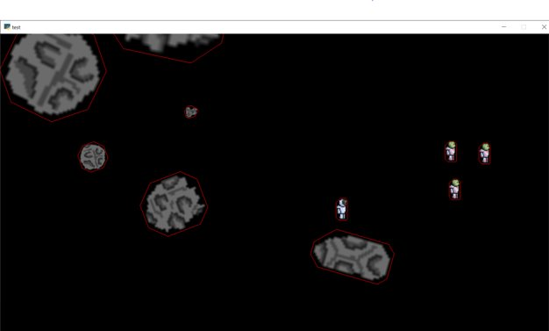
Screenshot of the game at the start of the sprint

Slide 4
Sprint Reflection and summary
I made the AI work on multiple enemies but i didn’t understand the physics engine enough to add it.
The ai will also maintain a distance from other ai's due to the flee function
The flee and seek function interact well with each other and look very nice and im really happy with it

Slide 5
Briefly describe other team members contributions
James finished the physics engine not including for enemies which is my fault. The games collision looks very nice and there doesn't seem to many problems
He also started helping me with the physics engine

Slide 6
Major Changes and Achievements Described
James has completed his part of the physics engine so all i have to do is complete enemy and all added features will work
I got the ai to work with multiple. All enemies will seek the mouse, and flee other enemies

Slide 7
Brief Description of your testing
The ai testing involved a lot of checking how the enemies interact with the flee function through trial and error and showing other people
To test the physics engine we run the game and collided the player into the meteors. The meteors didnt move much which was the intended result

Slide 8
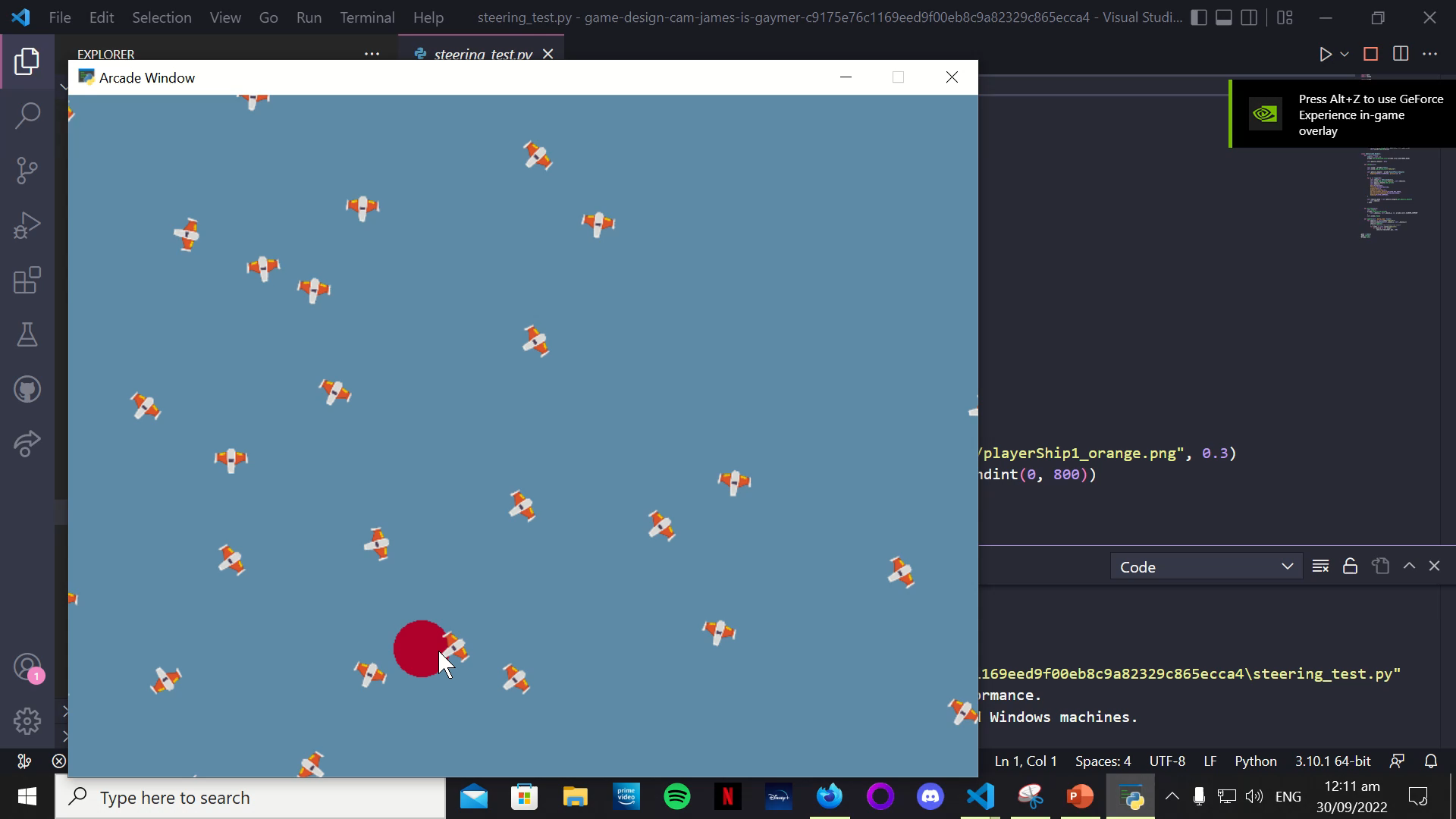
Link to testing results/tables

Slide 9
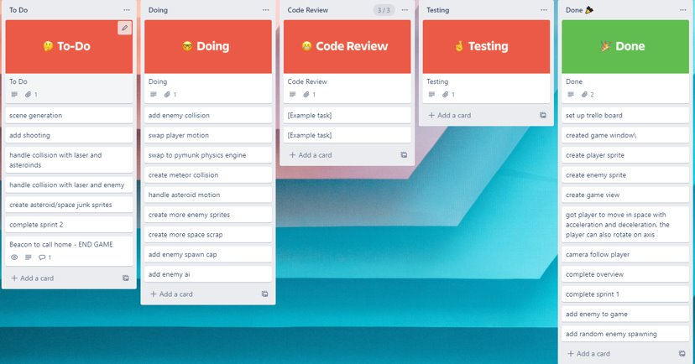
KANBAN board at the end of the sprint

Slide 10
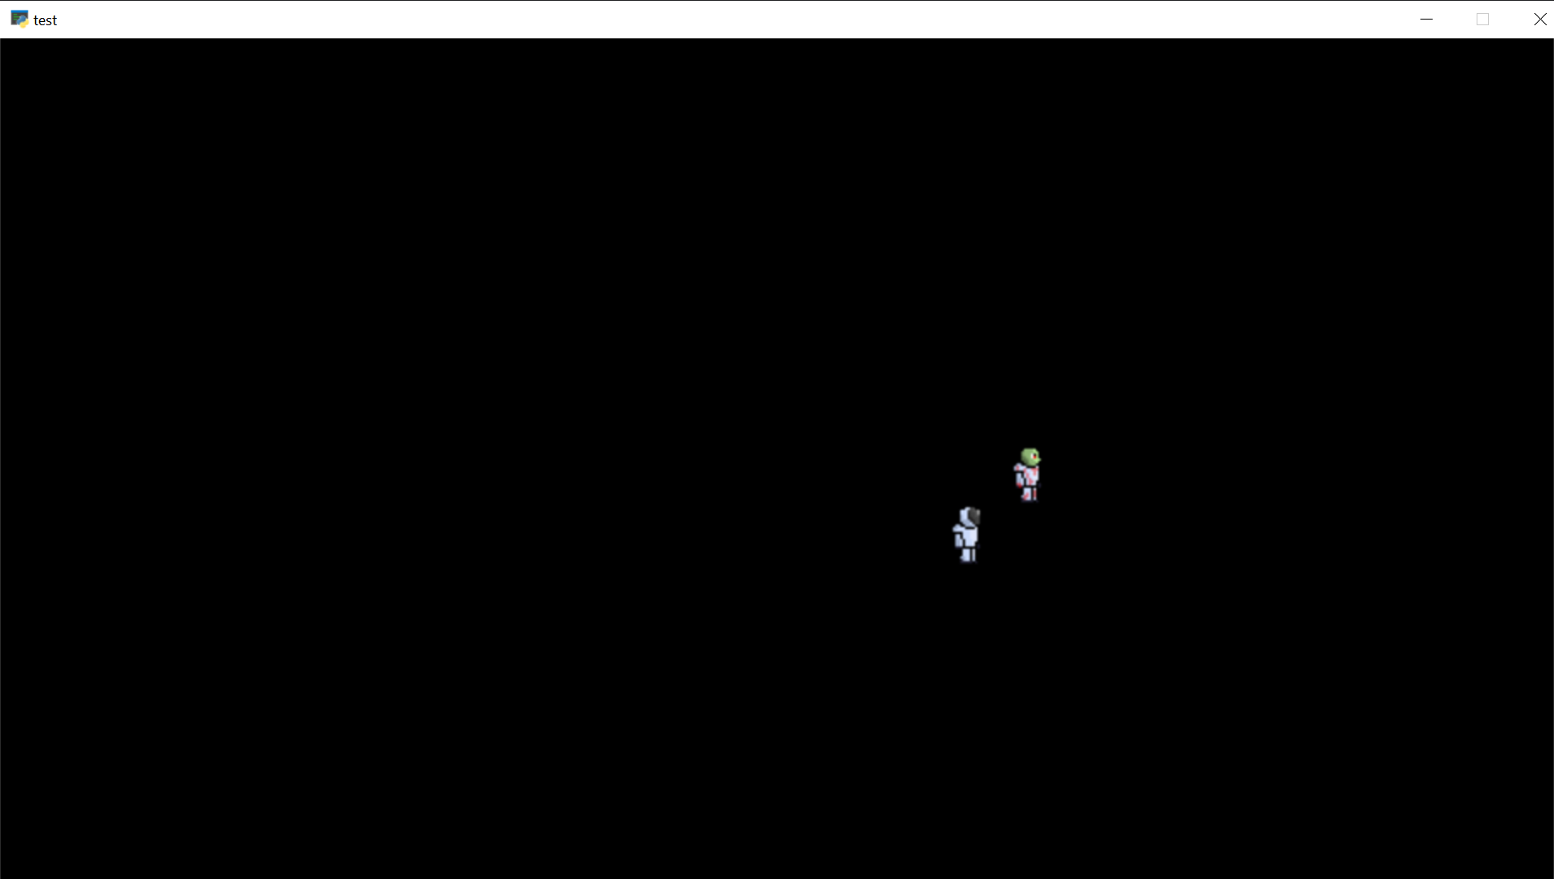
Screenshot of the game at the end of the sprint

Slide 11
Notes for next time, future improvements
Although the physics engine is done the enemies ai need to function before we can say that we have finished the physics engine so i need to work hard to complete the ai

Slide 12
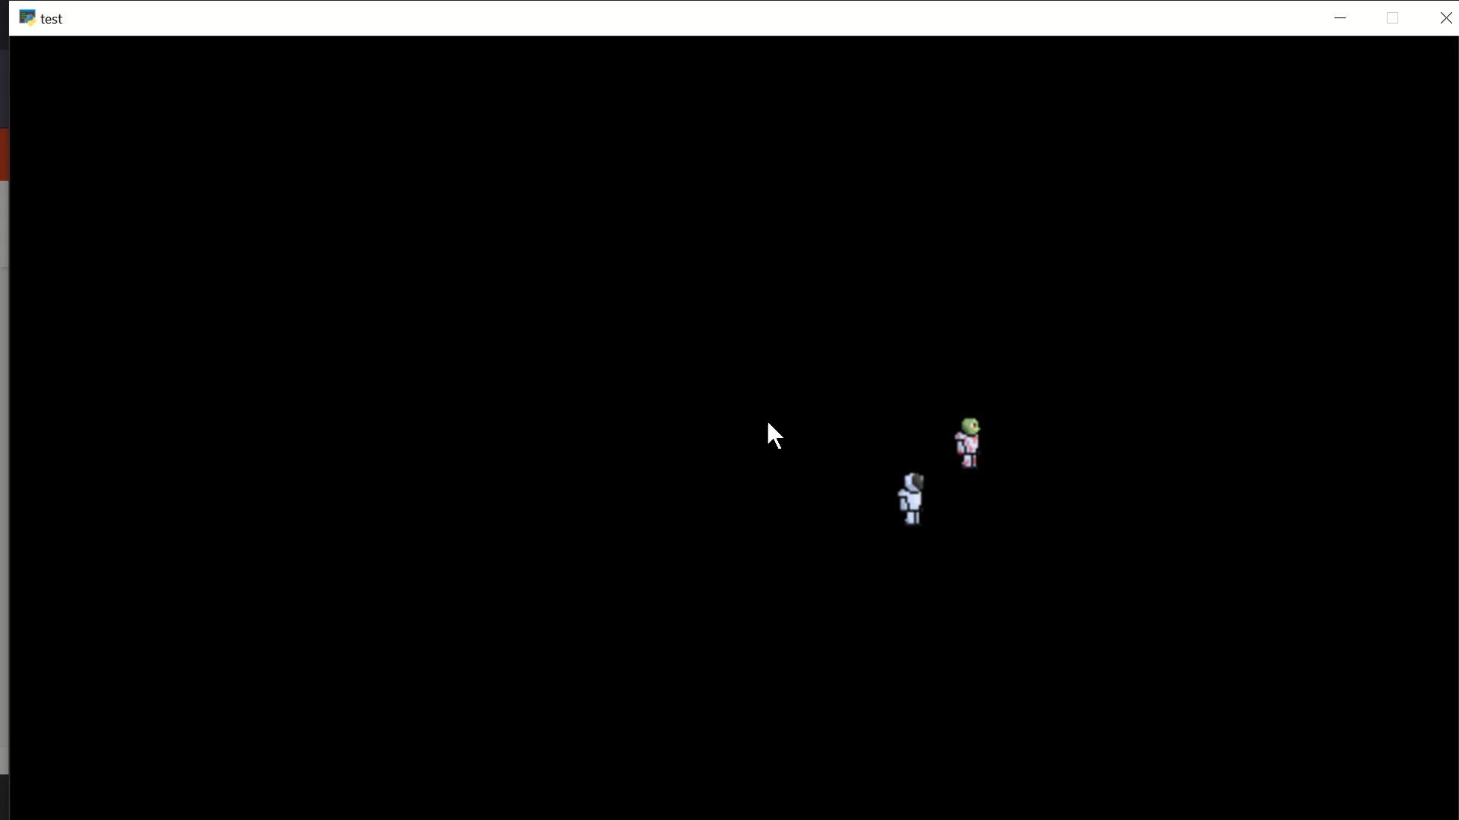
Video of the game at the end of the sprint

